Slide 1
Manifold Learning and Artificial Intelligence
Lecture 3
Generative AI
Meeting ID: 933 1613 9423
Passcode: 416262
https://uwmadison.zoom.us/j/93316139423?pwd=Q0NVWFYvRFg5RmxCNkwxMmYrbW41dz09
momiao. xiong@gmail.com
shihcheng.guo@gmail.com
Github Address: https://ai2healthcare.github.io/

Slide 2
Introduction 3
Generative AI
Early Stage:
Variational Autoencoder (VAE)
Generative Adversarial Neural Network (GAN)
Normalizing Flow
Current Stage
Score Match
Denoise Diffusion Probability Models
Stochastic Differential Equations (SDE)

Slide 3
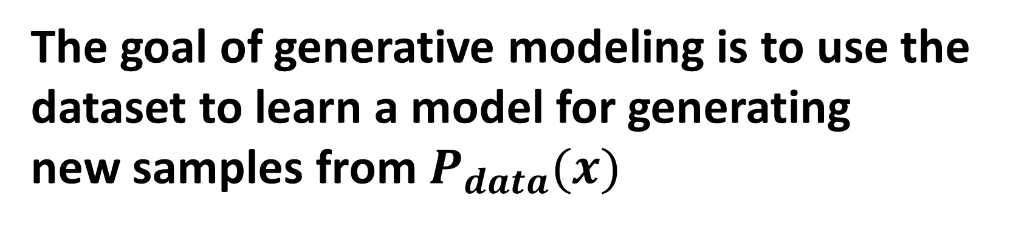
The goal of generative modeling is to use the dataset to learn a model for generating
new samples from $P_{data}(x)$
Sure enough, as the models get bigger and bigger, they begin to deliver human-level, and then superhuman results.
https://www.sequoiacap.com/article/generative-ai-a-creative-new-world/

Slide 4

1.4. Generative Models
1.4.1. Introduction
Analytic AI: nalyze a set of data and find patterns in it.
Generative AI: Use existing content like
text, audio files, or images to create
new plausible content.
The MIT Technology review described
generative AI as one of the most
promising advances in the world of AI
in the past decade
Generative AI is well on the way to becoming not just faster and cheaper, but better in some cases than what humans create by hand (SEQUOIA)
IBM developer blog. What is generative AI and how much power does it have

Slide 5

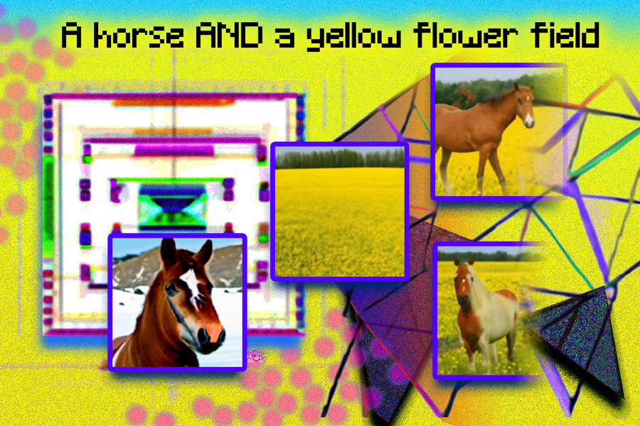
MIT AI and ML
Deep Generative Models
This course introduces how to develop deep generative models (DGMs) by integrating probabilistic graphical models and deep learning to generate realistic data including images, texts, graphs, etc. Course contents include 1) basics of probabilistic graphical models, including Bayesian network and Markov random field; 2) posterior inference methods, including message passing, variational inference, and Markov chain Monte Carlo sampling; 3) parameter learning and structure learning methods, including maximum likelihood estimation, expectation–maximization algorithm, and graphical LASSO; 4) deep generative models (DGMs), including variational auto-encoder, generative adversarial networks, normalizing flows, and evaluation of DGMs; 5) applications of DGMs in image generation, text generation, and graph generation.
https://www.csail.mit.edu/

Slide 6
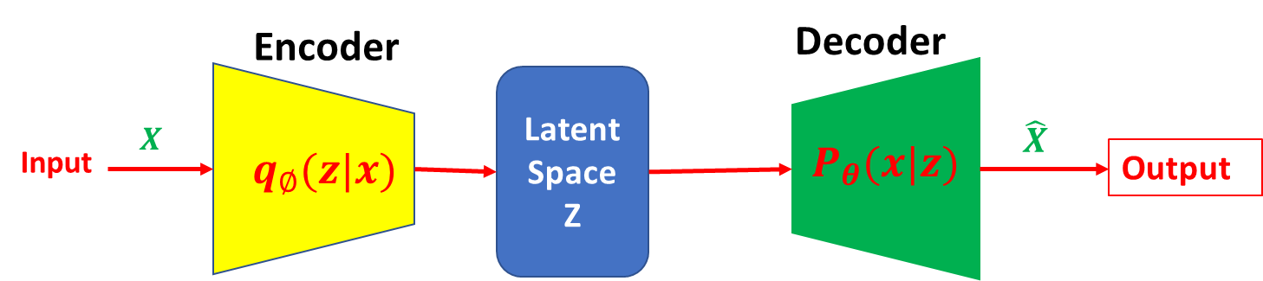
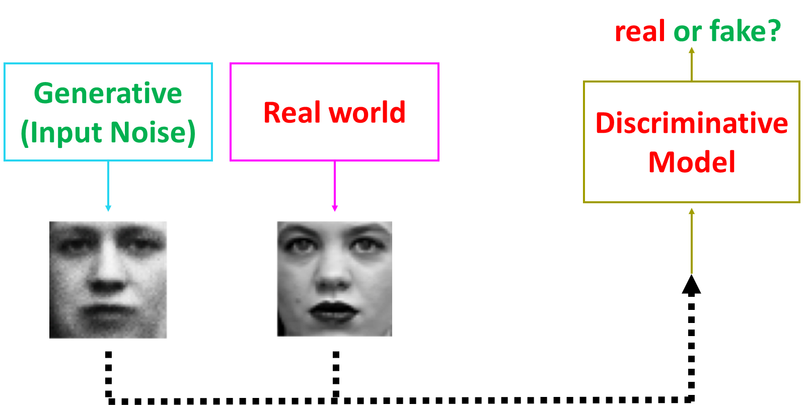
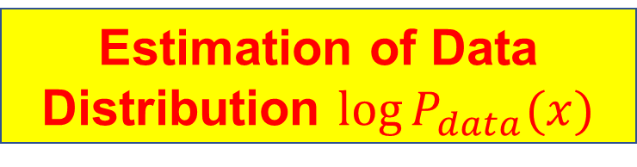
1.4.2. Stages of Generative Models
Basic Ideas:
Estimation of Data Distribution $\log{P_{data}(x)}$
Sampling from Estimated Data Distribution
Data
Early Stage
VAE
GAN

Slide 7
1.4.2. Stages of Generative Models
Current Stage
Score Match
Denoise Diffusion Probability Models
Stochastic Differential Equations

Slide 8
1.4.3. Score Match
1.4.3.1. Optimal Score
Let $L\left(x,θ\right)$ be a likelihood function. The score function is defined as
$U\left(θ\right)=\frac{∂\log{L(x,θ)}}{∂θ}$.
Define Scores in Diffusion Models:
Consider i.i.d. samples $\left\{x_{1}, …, x_{n}\right\}, x_{i}∈R^{d}$.
Unnormalized distribution for model:${\tilde{P}}_{m}(x, θ)$
Normalized distribution for model: $P_{m }\left(x,θ\right),P_{m }\left(x,θ\right)=\frac{{\tilde{P}}_{m}(x, θ)}{Z(θ)}. Z\left(θ\right)=\int{{\tilde{P}}_{m}\left(x, θ\right)dx}$
Score for Data: ${ S}_{data}\left(x\right)=∇_{x}\log{P_{data}(x)}$
Score for Model: $S_{m}\left(x,θ\right)=∇_{x}\log{P_{m}\left(x,θ\right)=∇_{x}\log{{\tilde{P}}_{m}(x,θ)}}$
Song et al. 2019, Sliced Score Matching: A Scalable Approach to Density and Score Estimation

Slide 9
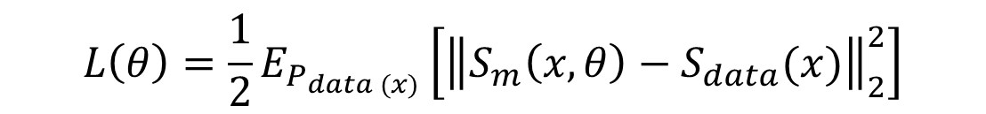
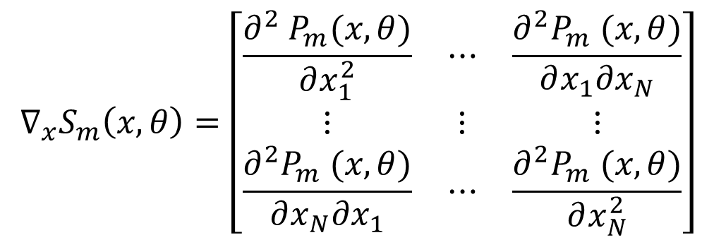
1.4.3.2. Fisher Divergence and Score Matching
Fisher Divergence between $P_{data}\left(x\right) and P_{m}(x,θ)$ :
$$L\left(θ\right)=\frac{1}{2}E_{P_{data (x)}}\left[{\left\|S_{m}\left(x, θ\right)−S_{data}(x)\right\|}_{2}^{2}\right]$$
Fisher divergence is equal to zero, if and only if two densities are equal.
Since we only have samples and do not have access to the score function of the data $S_{data}(x$), we cannot compute the Fisher divergence.
However, the Fisher divergence can be transformed to
$J\left(θ\right)=E_{p_{data(x)}}\left[Tr\left(∇_{x}S_{m}\left(x,θ\right)\right)+\frac{1}{2}{\left\|S_{m}(x,θ)\right\|}_{2}^{2}\right],$Tr denotes trace of matrix.,
$$∇_{x}S_{m}\left(x,θ\right)=\left[\begin{matrix}\frac{∂^{2} P_{m}(x,θ)}{∂x_{1}^{2}} & ⋯ & \frac{∂^{2}P_{m} (x,θ)}{∂x_{1}∂x_{N}} \\ ⋮ & ⋮ & ⋮ \\ \frac{∂^{2}P_{m} (x,θ)}{∂x_{N}∂x_{1}} & ⋯ & \frac{∂^{2}P_{m} (x,θ)}{∂x_{N}^{2}}\end{matrix}\right]$$
Is the Hessian of the log-density
function of model.

Slide 10

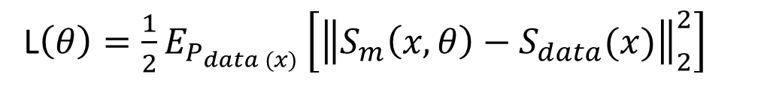
Sampling Formula for Computing Fisher Divergence:
$J\left(θ, x_{1}, …, x_{N}\right)=\frac{1}{N}\sum_{i=1}^{N}{\left[Tr\left(∇_{x}S_{m}\left(x_{i}, θ\right)\right)+\frac{1}{2}{\left\|S_{m}(x_{i}, θ)\right\|}_{2}^{2}\right]}$
Proof
L$\left(θ\right)=\frac{1}{2}E_{P_{data (x)}}\left[{\left\|S_{m}\left(x, θ\right)−S_{data}(x)\right\|}_{2}^{2}\right]$
$$=\frac{1}{2}E_{P_{data (x)}}\left[S_{data}^{T}\left(x\right)S_{data}\left(x\right)+S_{m}^{T}\left(x,θ\right)S_{m}\left(x,θ\right)−2S_{m}^{T}\left(x,θ\right)S_{data}\left(x\right)\right]$$
Since the first term does not depend on the parameter $θ$, we only need to consider the second and third terms in the above equation.
$${\frac{1}{2}E_{P_{data (x)}}[S}_{m}^{T}\left(x,θ\right)S_{m}\left(x,θ\right)]=\frac{1}{2}\sum_{i=1}^{n}{E_{P_{data (x)}}{[\left(S_{m}(x_{i},θ\right)}^{2}]}$$
$${\frac{1}{2}E_{P_{data (x)}}[2S}_{m}^{T}\left(x,θ\right)S_{data}\left(x\right)]=\sum_{i=1}^{n}{\int{P_{data}\left(x\right)}S_{m}}(x_{i},θ)\frac{∂\log{P_{data}(x_{i})}}{∂x_{i}}$$
$$=\sum_{i=1}^{n}{\int{S_{m}(x_{i},θ)\frac{∂P_{data}(x_{i})}{∂x_{i}}}dx_{i}}$$

Slide 11



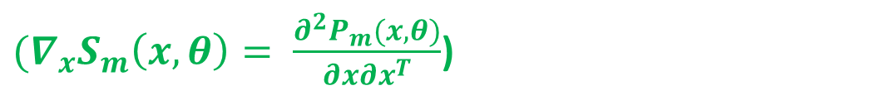
$$=\sum_{i=1}^{n}{\left[{P_{data}\left(x_{i}\right)S_{m}\left(x_{i},θ\right)|}_{−∞}^{∞}−\int{P_{data}(x_{i})\frac{∂S_{m}(x_{i},θ)}{∂x_{i}}dx_{i}}\right]}$$
$$=−\sum_{i=1}^{n}{E_{P_{data}}(x_{i})\frac{∂^{2}\log{P_{m}(x_{i},θ)}}{∂x_{i}^{2}}}$$
${(∇}_{x}S_{m}\left(x,θ\right)= \frac{∂^{2}P_{m}(x,θ)}{∂x∂x^{T}}$)
$$=−E_{P_{data}(x)}\left[Tr\left(∇_{x}S_{m}\left(x,θ\right)\right)\right]$$
which implies
$$J\left(θ\right)=E_{p_{data(x)}}\left[Tr\left(∇_{x}S_{m}\left(x,θ\right)\right)+\frac{1}{2}{\left\|S_{m}(x,θ)\right\|}_{2}^{2}\right]$$

Slide 12

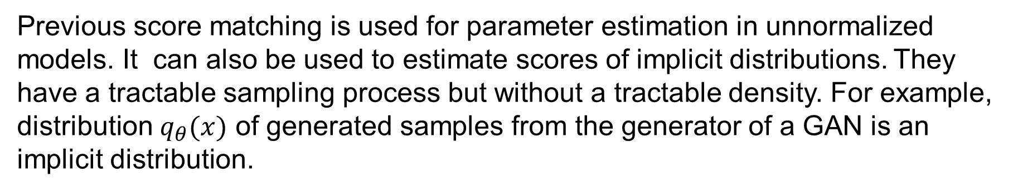
1.4.3.3. Score Estimation for Imlicit Distribution
Motivation
Previous score matching is used for parameter estimation in unnormalized models. It can also be used to estimate scores of implicit distributions. They have a tractable sampling process but without a tractable density. For example, distribution $q_{θ}(x)$ of generated samples from the generator of a GAN is an implicit distribution.
Sometimes, we need to estimate the score function $S_{q}\left(x\right)=∇_{x}\log{q_{θ}\left(x\right). }$For example, optimizing the entropy $H\left(q_{θ}\left(x\right)\right),$ we need to calculate score $S_{q}\left(x\right).$
Let $x\sim q_{θ}\left(x\right), x=g_{θ}\left(ε\right), ε\sim N\left(0,I\right), g_{θ}$ is a deterministic function. Then,
$$q_{θ}\left(x\right)=P_{θ}(ε){\left|∇_{ε}(g_{θ}\left(ε\right))\right|}^{−1}$$
$$∇_{θ}H\left(q_{θ}\right)=−∇_{θ}\left\{E_{q_{θ}\left(x\right)}\left[\log{q_{θ}\left(x\right)}\right]\right\}=−∇_{θ}\left\{E_{p(ε)}\left[\log{q_{θ}(g_{θ}\left(ε\right))}\right]\right\}$$
$$=−E_{p(ε)}\left[{\left.∇_{x}\log{q_{θ}\left(x\right)}\right|}_{x=g_{θ}\left(ε\right)}∇_{θ}g_{θ}(ε)\right]$$

Slide 13



1.4.3.4. Score Estimation
$∇_{x}\log{q_{θ}\left(x\right)}$ is intractable, but can be approximated by score function.
Score function:$h\left(x,θ\right):$ a neural network
$$x$$
$$h(x,θ)$$
$L\left(θ, P_{data}\left(x\right)\right)=\frac{1}{2}E_{P_{data}(x)}\left[{\left\|h\left(x,θ\right)−∇_{x}\log{q_{θ}\left(x\right)}\right\|}_{2}^{2}\right]$
$$L\left(θ, P_{data}\left(x\right)\right)=0 ↔h\left(x,θ\right)=∇_{x}\log{q_{θ}\left(x\right)}$$

Slide 14
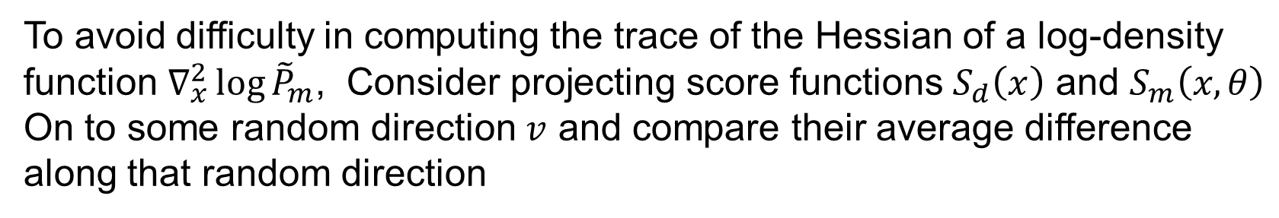
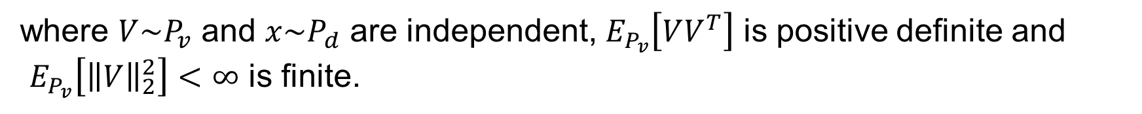
1.4.3.5. Sliced Score Matching
Motivation
To avoid difficulty in computing the trace of the Hessian of a log-density function $∇_{x}^{2}\log{{\tilde{P}}_{m}}$, Consider projecting score functions $S_{d}\left(x\right)$ and $S_{m}\left(x, θ\right)$
On to some random direction $v$ and compare their average difference along that random direction
Objective Function for Sliced Score Matching
$$L\left(θ, P_{v}\right)=\frac{1}{2}E_{P_{v}}E_{P_{d}}\left[{\left(V^{T}S_{m}\left(x,θ\right)−V^{T}S_{d}(x)\right)}^{2}\right]$$
(4.1)
where $V\sim P_{v}$ and $x\sim P_{d}$ are independent, $E_{P_{v}}\left[VV^{T}\right]$ is positive definite and
$E_{P_{v}}\left[{\left\|V\right\|}_{2}^{2}\right]<∞$ is finite.
Reduction
To eliminate the dependence of $L(θ, P_{v})$ on $S_{d},L\left(θ, P_{v}\right)$ can be reduced to
$$L\left(θ, P_{v}\right)=J\left(θ, P_{v}\right)+C$$
(4.2)
where $J\left(θ, P_{v}\right)= E_{P_{v}}E_{P_{d}}[V^{T}∇_{x}S_{m}\left(x,θ\right)V+\frac{1}{2}{\left(V^{T}S_{m}\left(x,θ\right)\right)}^{2}]$, $C$ is a constant.

Slide 15
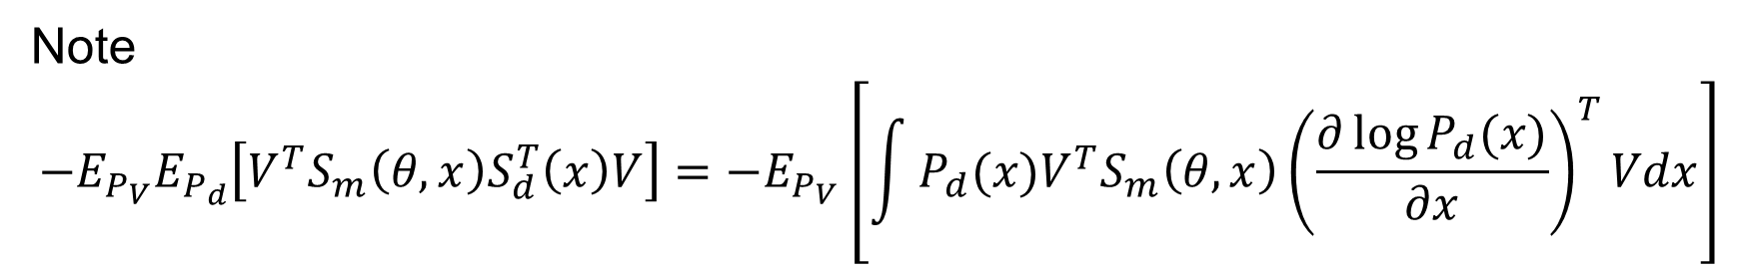

Proof
Let $C=\frac{1}{2}E_{P_{V}}E_{P_{d}}\left[{\left(V^{T}S_{d}(x)\right)}^{2}\right]$
(4.3)
Note
$$−E_{P_{V}}E_{P_{d}}\left[V^{T}S_{m}\left(θ,x\right)S_{d}^{T}\left(x\right)V\right]={−E}_{P_{V}}\left[\int{P_{d}(x)V^{T}S_{m}\left(θ,x\right){\left(\frac{∂\log{P_{d}(x)}}{∂x}\right)}^{T}Vdx}\right]$$
$=$ $E_{P_{V}}\left[−{\left.V^{T}S_{m}\left(θ,x\right)P_{d}^{T}\left(x\right)V\right\rfloor }_{−∞}^{∞}+\int{V^{T}∇_{x}S_{m}(x)P_{d}^{T}\left(x\right)Vdx}\right]$ (part by integration)
$$=E_{P_{V}}E_{P_{d}}\left\lceil V^{T}∇_{x}S_{m}\left(x\right)V\right\rceil$$
(4.4)
Substituting equations (4.3) and (4.4) into equatiom (4.1) yields equation (4.2).

Slide 16
1.4.3.6. Sampling Formula of Sliced Score
$$,$$
Let $X_{1}^{N}=\left\{x_{1},…, x_{N}\right\}$and $V_{11}^{NM}={\left\{V_{ij}\right\}}_{1≤i≤N, 1≤j≤M}$
Define Sampling Formula of $J\left(θ, P_{v}\right)$:
$$\hat{J}\left(θ, X_{1}^{NN}, V_{11}^{NM}\right)=\frac{1}{N}\frac{1}{M}\sum_{i−1}^{N}{\sum_{j=1}^{M}{\left[V_{ij}^{T}∇_{x}S_{m}\left(x_{i}, θ\right)V_{ij}+\frac{1}{2}{\left(V_{j}^{T}S_{m}(x_{i}, θ)\right)}^{2}\right]}}$$
(4.5)

Slide 17

1.4.3.7. Estimator with Reduced Variance
Assume that $V\sim N\left(0,I\right).$Then,
$${ E}_{P_{V}}\left[VV^{T}\right]=I$$
$$E_{P_{V}}\left[{\left(V^{T}S_{m}(x,θ)\right)}^{2}\right]=E_{P_{V}}\left[Tr\left({\left(V^{T}S_{m}(x,θ)\right)}^{2}\right)\right]$$
$$=E_{P_{V}}\left[Tr\left(\left(V^{T}S_{m}(x,θ\right){S_{m}(x,θ)}^{T}V\right)\right]$$
$$=E_{P_{V}}\left[{Tr(S}_{m}(x,θ){S_{m}\left(x,θ\right)}^{T}VV^{T})\right]$$
$={Tr(S}_{m}(x,θ){S_{m}\left(x,θ\right)}^{T}$ $E_{P_{V}}\left[VV^{T}\right]$)
$$={Tr(S}_{m}(x,θ){S_{m}\left(x,θ\right)}^{T})={\left\|S_{m}\left(x,θ\right)\right\|}_{2}^{2}$$
(4.6)
Substituting equation (4.6) into equation (4.2) yields
$$J_{vr}\left(θ, P_{v}\right)= E_{P_{v}}E_{P_{d}} \left[V^{T}∇_{x}S_{m}\left(x,θ\right)V+\frac{1 }{2}{\left\|S_{m}\left(x,θ\right)\right\|}_{2}^{2}\right]$$
(4.7)

Slide 18
$${\hat{J}}_{vr}\left(θ, X_{1}^{NN}, V_{11}^{NM}\right)=\frac{1}{N}\frac{1}{M}\sum_{i−1}^{N}{\sum_{j=1}^{M}{\left[V_{ij}^{T}∇_{x}S_{m}\left(x_{i}, θ\right)V_{ij}+\frac{1}{2}{\left\|S_{m}\left(x_{i}, θ\right)\right\|}_{2}^{2}\right]}}$$
(4.8)
Song et al. 2019, Sliced Score Matching: A Scalable Approach to Density and Score Estimation

Slide 19




1.4.3.8. Algorithm for Sliced Score Matching
Step 1: Input ${\tilde{P}}_{m}\left(.;θ\right), x, V$
Step 2: $S_{m}(x;θ)←∇_{x}\log{{\tilde{P}}_{m}(x,θ)}$
Step 3: $V^{T}∇_{x}S_{m}(x,θ)←∇_{x}\left(V^{T}S_{m}(x,θ)\right)$
Step 4: $J←\frac{1}{2}{\left(V^{T}S_{m}(x,θ)\right)}^{2}$ (or $\frac{1 }{2}{\left\|S_{m}\left(x,θ\right)\right\|}_{2}^{2})$
Step 5: $J←J+V^{T}∇_{x}S_{m}\left(x,θ\right)V$
Step 6: Output $J$

Slide 20
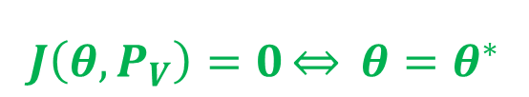
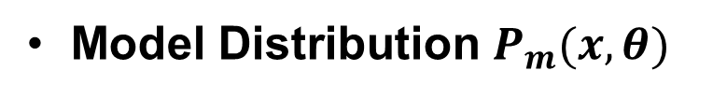



1.4.3.9. Consistency of Estimator
Data Distribution $P_{d}(x)$
Model Distribution $P_{m}(x,θ)$
$$J\left(θ,P_{V}\right)=0\underset{⇔}{} θ=θ^{∗}$$
$$P_{m}\left(x,θ^{∗}\right)=P_{d}(x)$$
Let
$${\hat{θ}}_{N.M}→θ$$
$${\hat{θ}}_{N,M}=\underset{θ}{argmin}{\hat{J}(θ, X_{1}^{N}, V_{11}^{N})}$$
Then, for a fixed $M,$under some regular conditions
$${\hat{θ}}_{N,M}\underset{→}{p}θ^{∗}, N→∞$$

Slide 21
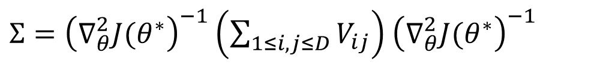
1.4.3.10. Asymptotic Normality
Under some assumptions, we have
$$\sqrt{N}({\hat{θ}}_{N,m}−θ^{∗})\underset{→}{d}N(0, Σ)$$
where
$Σ={\left(∇_{θ}^{2}J(θ^{∗}\right)}^{−1}\left(\sum_{1≤i,j≤D}{V_{ij}}\right)$ ${\left(∇_{θ}^{2}J(θ^{∗}\right)}^{−1}$

Slide 22
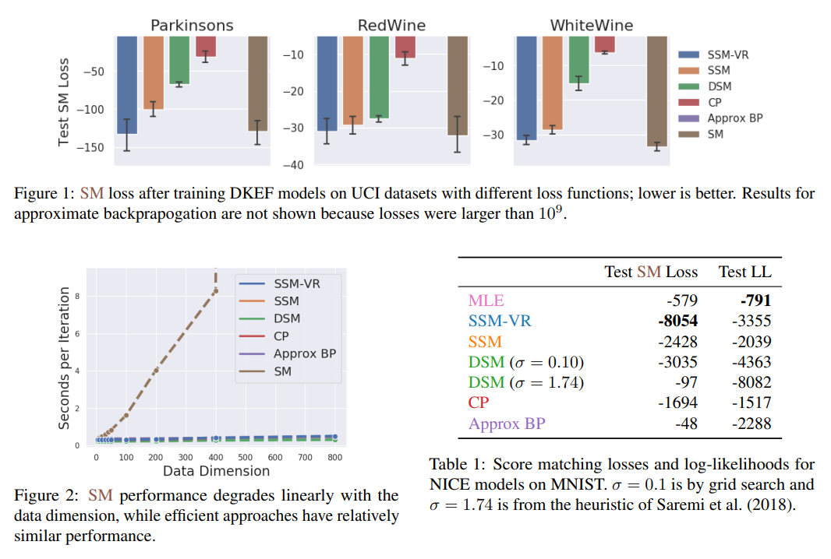

Slide 23
1.4.3.11. Challenges of score-based generative modeling
Data are located in low dimensional manifold, not in the entire database, including high dimensional ambient space.
Since the score $∇_{x}\log{P_{data}(x)}$ may be taken in the ambient space, it is undefined when $x$ is only located in a low dimensional manifold.
Score matching algorithm provides a consistent score estimator only when the support of the data distribution is in the entire space.
We then produce samples using Langevin dynamics, which approximately works by gradually moving a random initial sample to high density regions along the (estimated) vector field of scores
Son and Ermon, 2020. Generative Modeling by Estimating Gradients of the Data Distribution

Slide 24
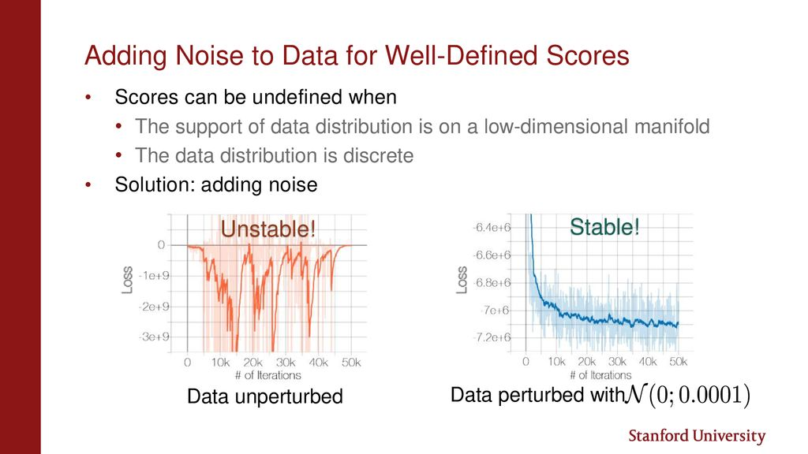

Slide 25
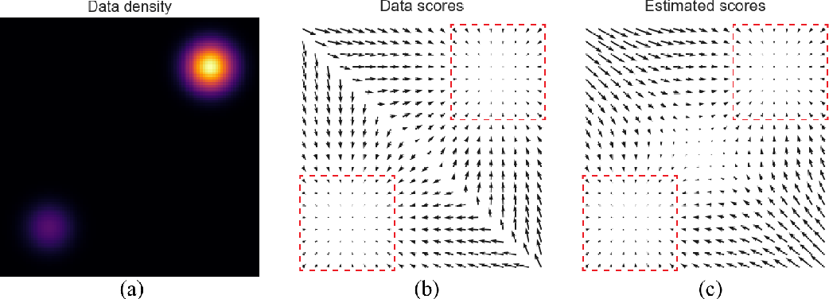
$$P_{data}\left(x\right)=\frac{1}{5}N\left(\left(−5,−5\right),I\right)+\frac{4}{5}N(\left(5,5\right),I)$$

Slide 26
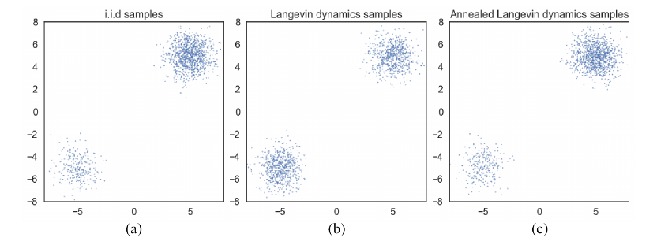

Slide 27
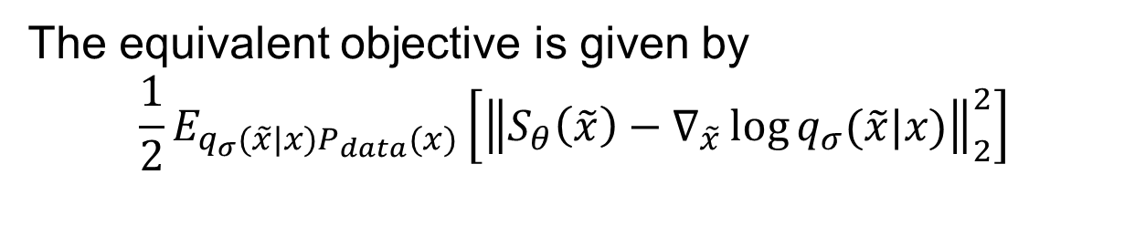
1.4.3.11. Denoising score matching
Step 1:
To avoid computing cost of $Tr\left(∇_{x}S_{m}\left(x,θ\right)\right)$, we first perturb the data $x$with a pre-specified noise distribution $q_{σ}\left(\tilde{x} | x\right).$
Step 2:
Then, employ score matching to estimate the score of the perturbed data distribution
$$q_{σ}\left(\tilde{x}\right)=\int{q_{σ}\left(\tilde{x} | x\right)P_{data}\left(x\right)dx}$$
Step 3:
The equivalent objective is given by
$$\frac{1}{2}E_{q_{σ}(\tilde{x}|x)P_{data}(x)}\left[{\left\|S_{θ}\left(\tilde{x}\right)−∇_{\tilde{x}}\log{q_{σ}(\tilde{x}|x)}\right\|}_{2}^{2}\right]$$
Note that $∇_{\tilde{x}}\log{q\left(\tilde{x}\right)=∇_{\tilde{x}}\left[\log{q_{σ}\left(\tilde{x} | x\right)+\log{P_{data}\left(x\right)}}\right]}=∇_{\tilde{x}}\log{q_{σ}\left(\tilde{x} | x\right)}$

Slide 28
Step 4:
The optimal score network minimizes the above objective functions satisfies
$$S_{θ^{∗}}\left(x\right)=∇_{x}\log{q_{σ}(x)≈∇_{x}\log{P_{data}(x)}}$$
when the noise is small such that
$$q_{σ}(x)≈P_{data}(x)$$

Slide 29
Built upon this intuition, we propose to improve score-based generative modeling by
1) perturbing the data using various levels of noise; and
2) simultaneously estimating scores corresponding to all noise levels by training a single conditional score network.

Slide 30
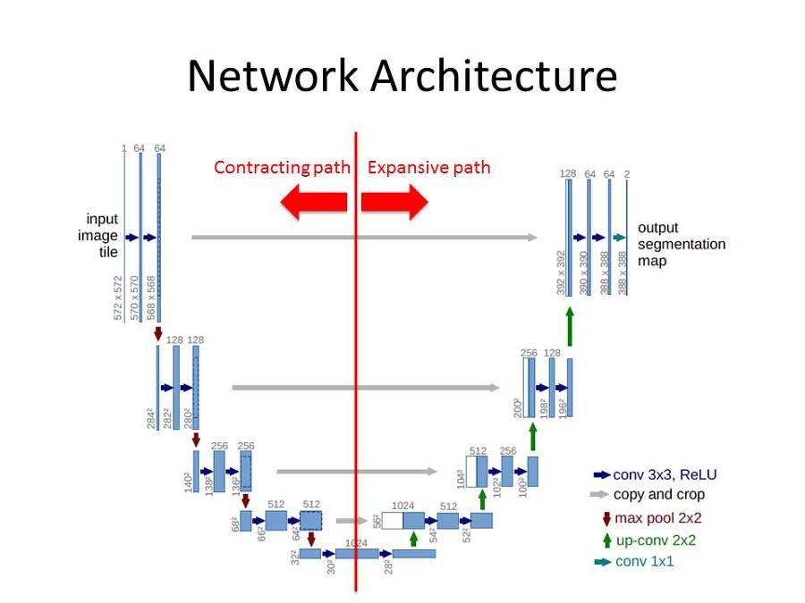
1.4.3.12. Generative Model by Score Matching
Ronneberger et al. 2015. U-Net Convolutional Networks for Biomedical Image Segmentation

Slide 31
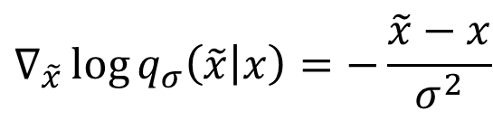

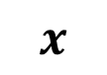
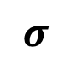

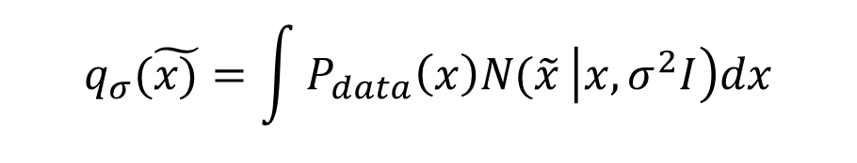

Noise Conditional Score Network $S_{θ}(x,σ)$
Define
$${\left\{σ_{i}\right\}}_{i=1}^{L}, \frac{σ_{1}}{σ_{2}}=…=\frac{σ_{L−1}}{σ_{L}}>1$$
$$σ$$
NN
$$S_{θ}(x,σ)$$
$$q_{σ}(\tilde{x)}=\int{P_{data}\left(x\right)N(\tilde{x}}\left|x, σ^{2}I\right)dx$$
$$x$$
$$∇_{\tilde{x}}\log{q_{σ}\left(\tilde{x} | x\right)=−\frac{\tilde{x}−x}{σ^{2}}}$$
Objective Function
$$l\left(θ, σ\right)=\frac{1}{2}E_{P_{data}(x)}E_{\tilde{x}\sim N(x, σ^{2})}\left[{\left\|S_{θ}\left(\tilde{x},σ\right)+\frac{\tilde{x}−x}{σ^{2}}\right\|}_{2}^{2}\right]$$
$$l\left(θ,{\left\{σ_{i}\right\}}_{i=1}^{L}\right)=\frac{1}{L}\sum_{i=1}^{L}{λ\left(σ_{i}\right)l(θ, σ_{i})}$$
$$S_{θ}\left(\tilde{x},σ\right)=∇_{\tilde{x}}\log{q_{σ}\left(x\right),λ\left(σ_{i}\right)=σ_{i}^{2}}$$

Slide 32
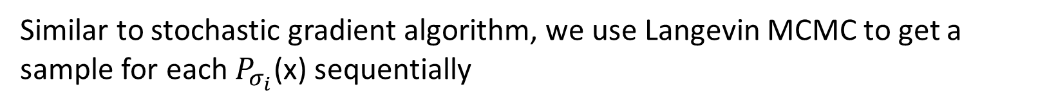
1.4.3.12. Stochastic Gradient and Langevin MCMC
(Algorithm 1)
Step 1: Solve
$$θ^{∗}=\underset{θ}{argmin}{\sum_{i=1}^{n}{σ_{i}^{2}E_{P_{data}(x)}E_{P_{σ_{i}}}\left[{\left\|S_{θ}\left(\tilde{x},σ_{i}\right)−∇_{\tilde{x}}\log{P_{σ_{i}}(\tilde{x}|x)}\right\|}_{2}^{2}\right]}}$$
Step 2:
Similar to stochastic gradient algorithm, we use Langevin MCMC to get a sample for each $P_{σ_{i}}$(x) sequentially
$$x_{i}^{m}$$
$$x_{i}^{m}=x_{i}^{m−1}+ε_{i}∇_{x}\log{P_{σ_{i}}\left(x_{i}^{m−1}\right)+\sqrt{2ε_{i}}z_{i}^{m}}$$
$=x_{i}^{m−1}+ε_{i}S_{θ^{∗}}\left(x_{i}^{m−1}, σ_{i}\right)+\sqrt{2ε_{i}}z_{i}^{m}, m=1,…, M, ε_{i}>0,z_{i}^{m}$ is standard normal.
Step 3: Repeat for $i=N, N−1, …, 1,$ with $x_{N}^{0}\sim N\left(x | 0, σ_{max}^{2}I\right), x_{i}^{0}=x_{i+1 }^{M}$for $i<N$
As $M→∞$ and $ε_{i}>0,$for all $i, x_{1}^{M}$ becomes an exact sample from $P_{σ_{min}}≈P_{data}\left(x\right).$

Slide 33


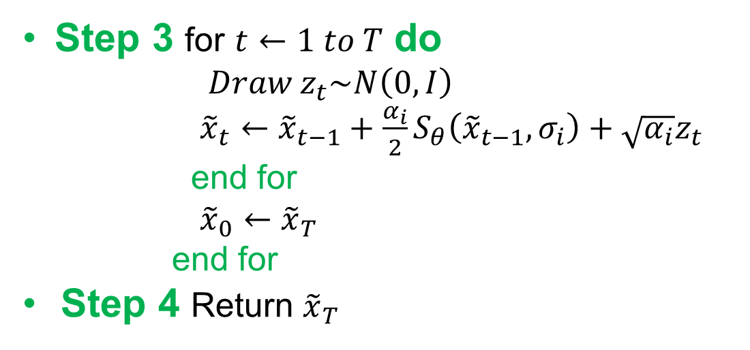


1.4.3.12. Stochastic Gradient and Langevin MCMC
(Algorithm 2)
Input ${\left\{σ_{i}\right\}}_{i=1}^{L}, ε, T$
Step 1 Initialize ${\tilde{x}}_{0}$
Step 2 For $i←1 to L$do
$$α_{i}←ε\frac{σ_{i}^{2}}{σ_{L}^{2}}$$
Step 3 for $t←1 to T$ do
$$Draw z_{t}\sim N\left(0,I\right)$$
${\tilde{x}}_{t}←{\tilde{x}}_{t−1}+\frac{α_{i}}{2}S_{θ}\left({\tilde{x}}_{t−1}, σ_{i}\right)+\sqrt{α_{i}}z_{t}$
end for
${\tilde{x}}_{0}←{\tilde{x}}_{T}$
end for
Step 4 Return ${\tilde{x}}_{T}$

Slide 34
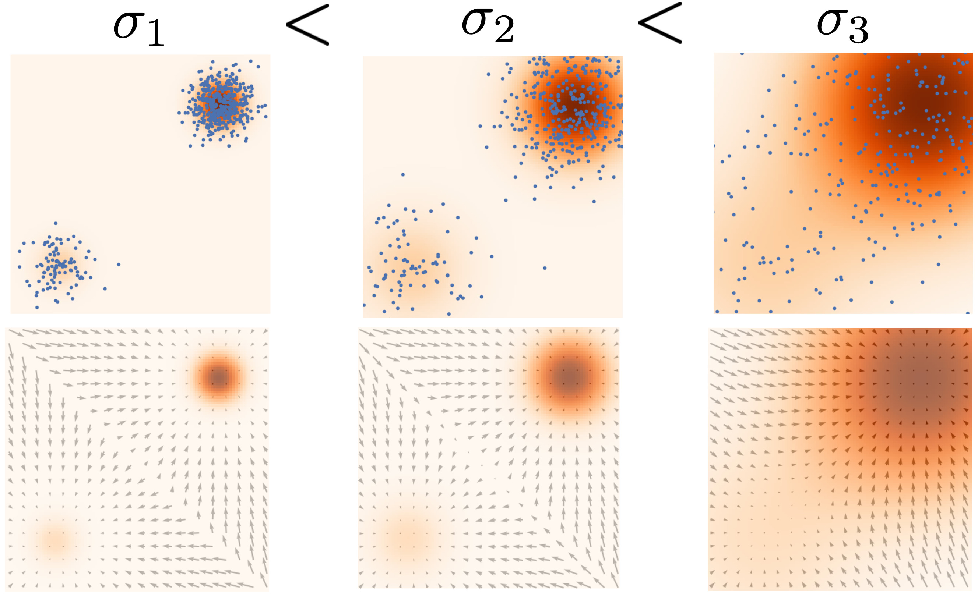

Slide 35
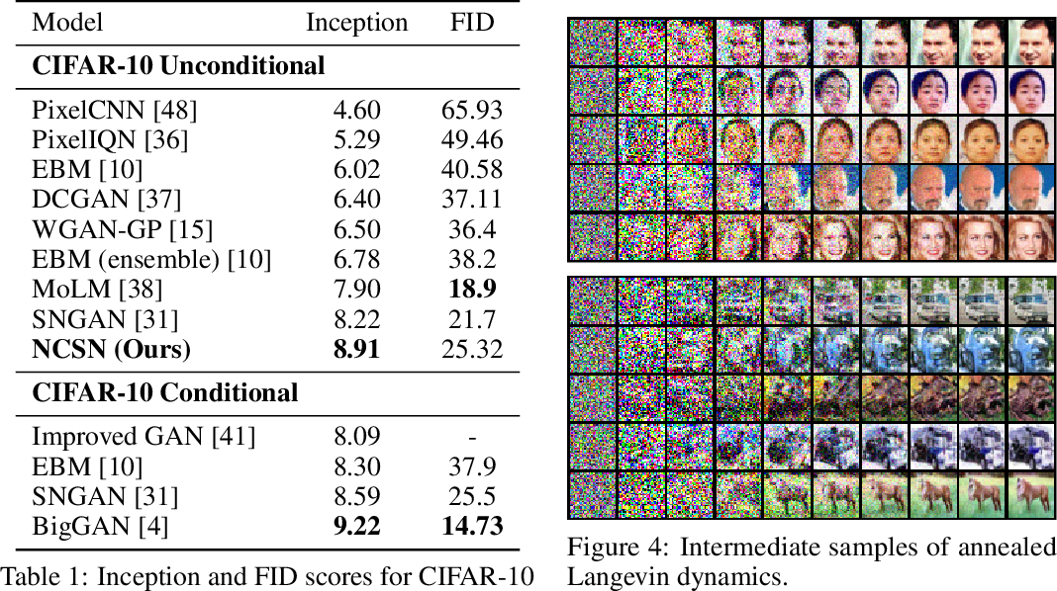

Slide 36
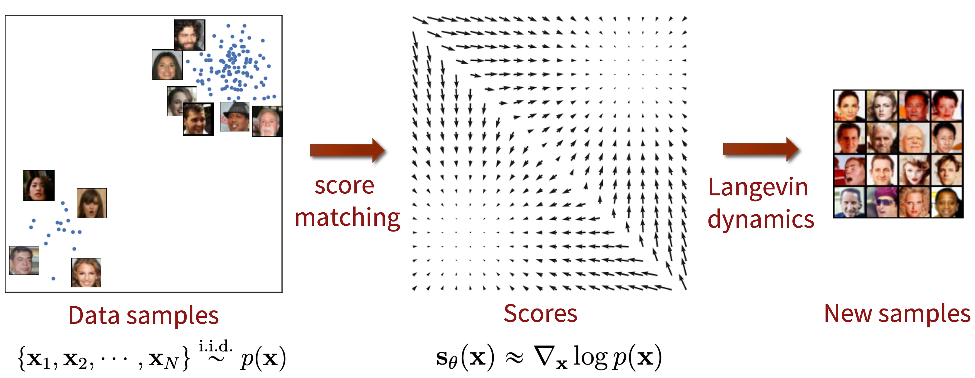

Slide 37
